Slide 1
User Experience(UX) / User Interface(UI)
Nima Atashin – Mahdieh Kazemi
Sina kargaran – Marzieh Alidadi

Slide 2
What user experience (UX) means and how it matters

Slide 3
What user experience (UX) means and how it matters
Marzieh Alidadi

Slide 4
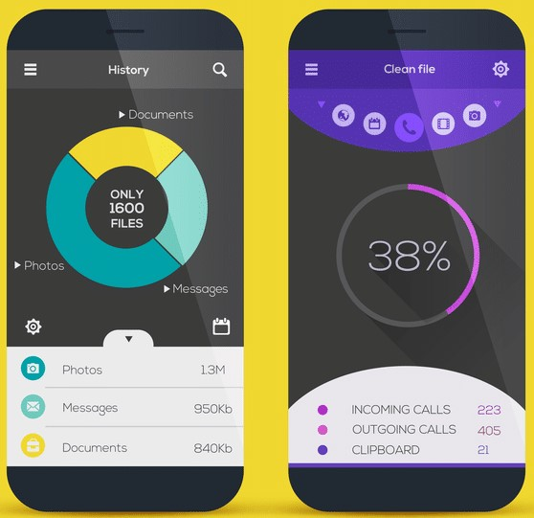
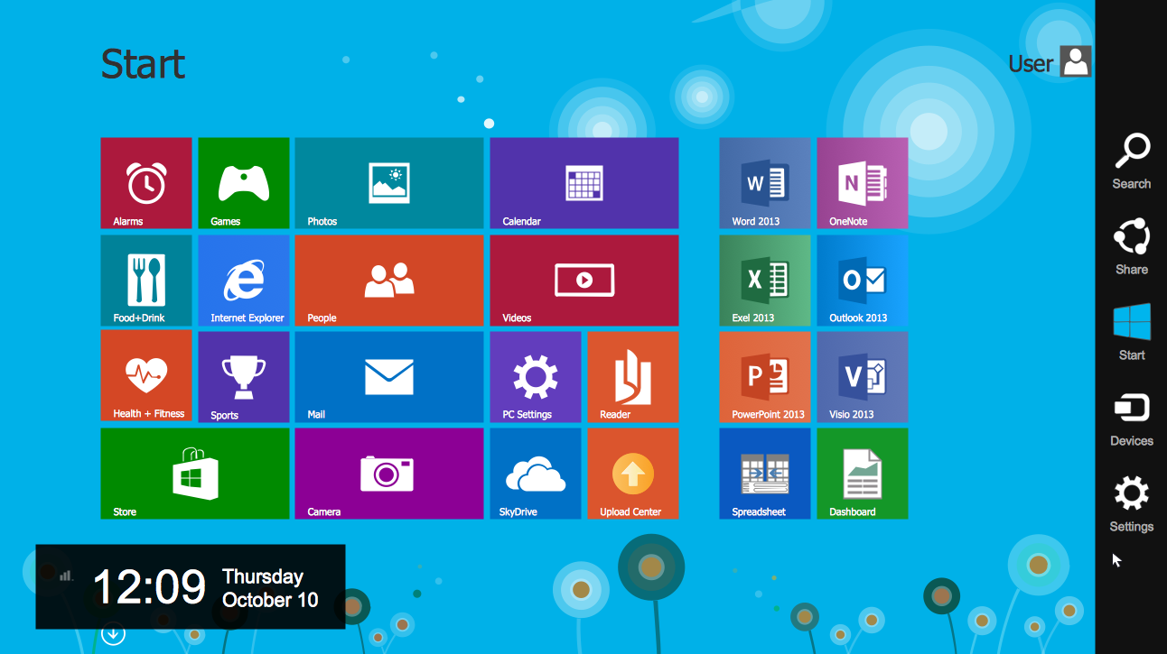
We all experience User Interfaces

Slide 5
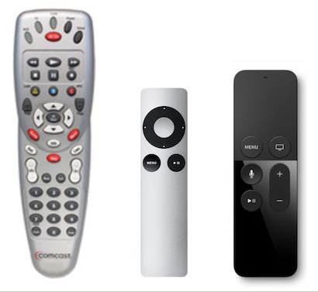

Even in a different sort

Slide 6
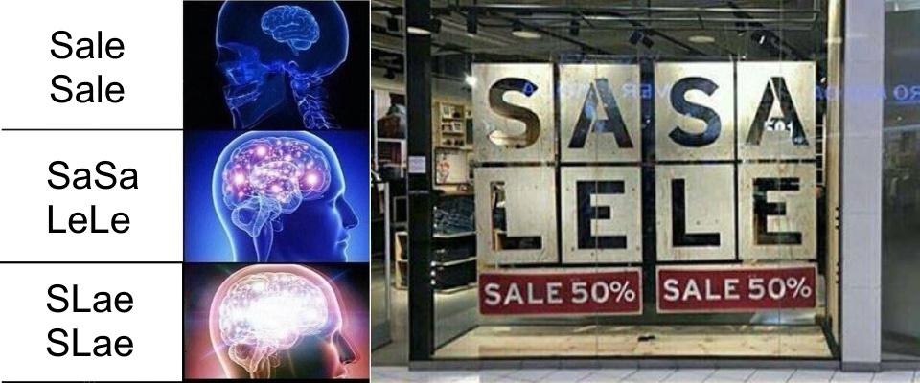
Some are cofusing

Slide 7
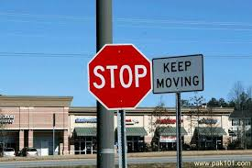
Really confusing

Slide 8
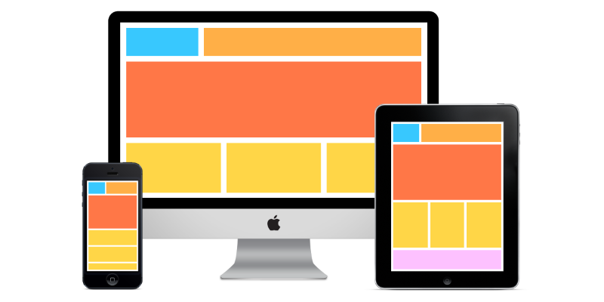
What Is User Interface? (UI)
It is the means in which a person controls a software application or hardware device.
While user interfaces can be designed for either hardware of software, most are a combination of both. For example, to control a software program, you typically need to use a keyboard and mouse, which each have their own user interface.
A good user interface provides a "user-friendly" experience, allowing the user to interact with the software or hardware in a natural and intuitive way.
https://techterms.com/definition/user_interface
https://www.webfuel.com/what-is-a-responsive-user-interface

Slide 9
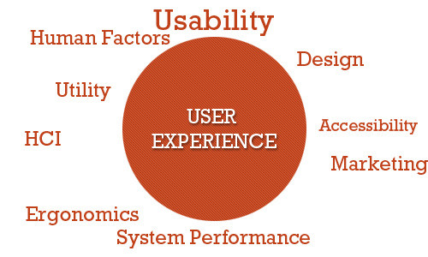
What Is User Experience? (UX)
User experience (abbreviated as UX) is how a person feels when interfacing with a system. The system could be a website, a web application or desktop software and, in modern contexts, is generally denoted by some form of human-computer interaction (HCI).
https://www.smashingmagazine.com/2010/10/what-is-user-experience-design-overview-tools-and-resources/

Slide 10
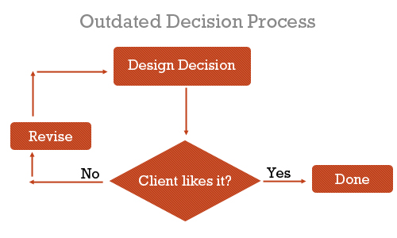
Why Is UX Important?
Nowadays, with so much emphasis on user-centered design, describing and justifying the importance of designing and enhancing the user experience seems almost unnecessary. We could simply say, “It’s important because it deals with our users’ needs — enough said,” and everyone would probably be satisfied with that.
Before our clients (and we) understood the value of user-centered design, we made design decisions based on just two things: what we thought was awesome and what the client wanted to see.
https://www.smashingmagazine.com/2010/10/what-is-user-experience-design-overview-tools-and-resources/

Slide 11
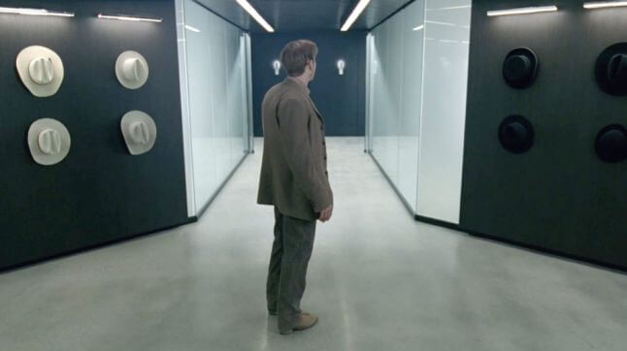
How Can Bad UX Design Kill You in the Future? (I)
For most of us, a bad user experience means only a bit of frustration or a waste of time. But in some cases, bad UX design can severely harm or even kill people. As we allow technology to infiltrate every field of our lives, bad UX design could become even more dangerous in the future. We don’t have to look that far into the future to find some dangerous UX mistakes…
https://uxstudioteam.com/ux-blog/bad-ux-design/

Slide 12
How Can Bad UX Design Kill You in the Future? (II)
- What is a “bad user experience” for you?
If you ask this question from most of the people, these would be their answers:
“When I can’t find anything. When things aren’t where they are supposed to be.”
“Waste of time, struggling. And getting annoyed.”
“I get angry and usually I leave the app or website.”
“When something is too slow for example. That’s a bad experience.”
No one talked about feeling fear, serious pain or injury. I had a feeling that bad UX design is more like an annoying fly in the room, not a serious threat. That’s also because we usually connect user experience with digital products and we think them physically harmless.
https://uxstudioteam.com/ux-blog/bad-ux-design/

